Slide 1
What you are turning in NOW…
Lab #6: The Kingdom Protista
Pre-Lab exercise check for completion (96),
Lab Questions (97 – 99)
Lab #7: The Plant and Animal Kingdom
Pre-Lab exercise check for completion (107)

Slide 2
Due in TWO weeks!!!
Lab #7: The Plant and Animal Kingdom
Pre-Lab exercise for accuracy (107),
Lab Questions (108, 110, & 112)
Lab #8: Photosynthesis
Pre-Lab exercise to check for completion (119 - 121)
EXTRA CREDIT OP!

Slide 3
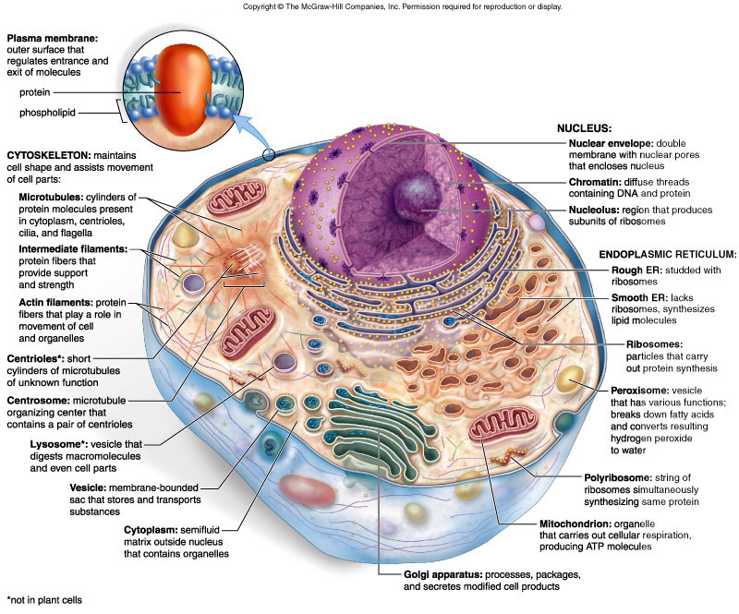
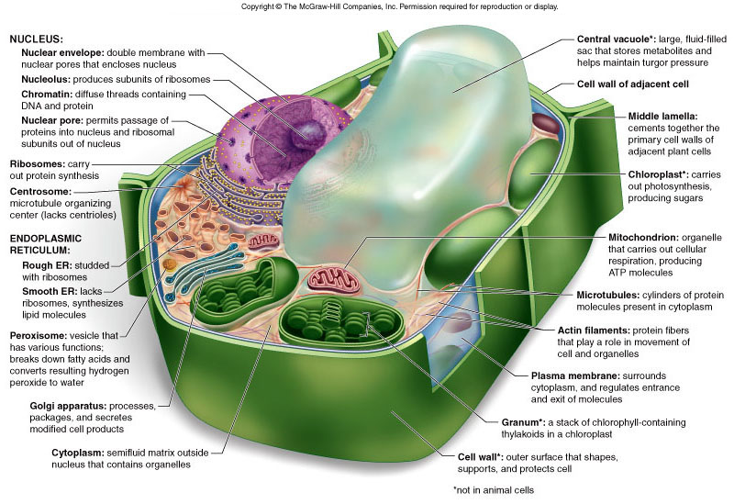
What are organisms classified under Kingdoms Plantae and Animalia?
Multicelluar, eukaryotic cells
Plants are autotrophs
Animals are heterotrophs

Slide 4
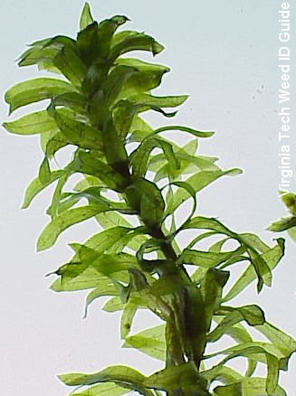
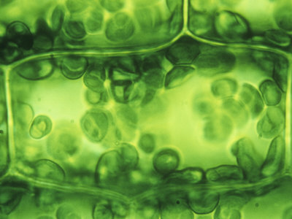
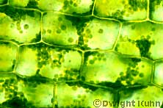
http://www.ppws.vt.edu/scott/weed_id/belodea12-28.jpg
http://cache2.artprintimages.com/p/LRG/38/3815/3GBYF00Z/art-print/robert-calentine-elodea-leaf-cell-with-numerous-chloroplasts.jpg
Elodea
Aquatic weed that can be found throughout the southeastern United States in ponds, lakes, streams, and rivers
Note the chloroplast (circular green structures)
http://www.kuhnphoto.com/gallery/biology/microscopic/px9-6d.jpg

Slide 5
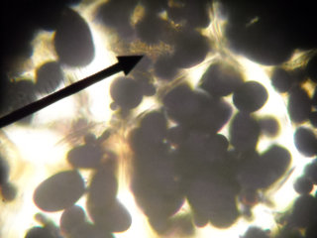
http://www.classhelp.info/Biology/LabPotato.jpg
Potato Tuber Cell
root vegetable
leucoplast used for
starch storage
stains purple in KI

Slide 6
Gall Bladder: animal cell example
organ that aids in fat digestion
several layers – epithelia layer
note HOW the nucleus and the
plasma membrane (cytoplasm) are
arranged

Slide 7
Cheek Epithelium: another animal cell
eukaryotic animal cell
note where the nucleus is (dark region of
the cell)
be VERY CAREFUL when scraping cheek
cells!!! We are NOT looking at your blood
so DO NOT GO NUTS!!!

Slide 9
Part I & II: Microscopic observation
Observe prepared slides of a gall bladder.
Observe the slides YOU construct of:
cheek epithelia
onion
potato
LABEL: cell wall,
cell membrane,
nucleus, and
cytoplasm

Slide 10
Time to see
what we can see!!!
Your microscope skills will come into play here. The more efficient you can get to the specimen, the quicker you will be done with the exercise.

Slide 11
HELPFUL HINT #1
STOP looking to the stage
to focus on your specimen!!!
That’s what the
OCCULAR LENSES are for!!!

Slide 12
Demand #1 (and #2 and #3)
When switching specimens…
1. Use the nosepiece to turn objective lens to 4X
2. Use course adjustment knob to move stage ALL the way down
3. NOW you can switch out the slide

Slide 13
Part III: Determining effects
of salt concentration
Environment pH is important for the growth and survival of living organisms.
Students will be assigned to prepare a 1%, 5% and 9% salt solution for the entire class (use 100 mL total volume!!!)
1% of 100 mL
100 x 0.01 = 1
Add 1 gram of NaCl in a beaker, and bring up to 100 mL in volume with water.
Add 1 gram of NaCl
Bring up to 100 mL with water
How do you prepare a 5%, 100 mL NaCl solution?
How do you prepare a 9%, 100 mL NaCl solution?

Slide 14
hypertonic
a
Imagine a cell in a10% salt solution…
hypotonic
10% solute
90% water
1.What is the water concentration inside the cell? Outside the cell?
2. Where will water move?
2% solute
98% water
Inside the cell = 98%
Outside the cell = 90%
Because the concentration of water is higher inside the cell, it will move to the area of lower concentration. Therefore, water will move outside the cell.
The solution outside the cell is described as “hypertonic” as it is able to pull water to it. Hypertonic solutions tend to have more solutes that solvent.
The solution inside the cell is hypotonic relative to the solution outside the cell.

Slide 15
b
hypotonic
Imagine a cell in a 2% salt solution…
2% solute
hypertonic
98% water
1.What is the water concentration inside the cell? Outside the cell?
2. Where will water move?
12% solute
88% water
Inside the cell = 88%
Outside the cell = 98%
Because the concentration of water is higher outside the cell, it will move to the area of lower concentration. Therefore, water will move inside the cell.
The solution outside the cell is described as “hypotonic” as it is unable to pull water to it. Hypotonic solutions tend to have little solutes than solvent.
The solution inside the cell is hypertonic relative to outside the cell.

Slide 16
c
isotonic
Imagine a cell in a 5% salt solution…
5% solute
isotonic
95% water
1.What is the water concentration inside the cell? Outside the cell?
2. Where will water move?
5% solute
95% water
Inside the cell = 95%
Outside the cell = 95%
The concentration of water is equal both inside and outside the cell. Water will continuously move in and out of the cell. However, the net movement of water is zero.
This solution is described as “isotonic”.
The concentration of water is equal at either side of the membrane.
Water will continue to move but there is no one side that has a pulling power.
Thus, the movement of water cancels out and this solution is at an equilibrium.

